Slide 1
For a Synodal Church: Communion, Participation, and Mission
General Secretariat of the Synod of Bishops

Slide 2
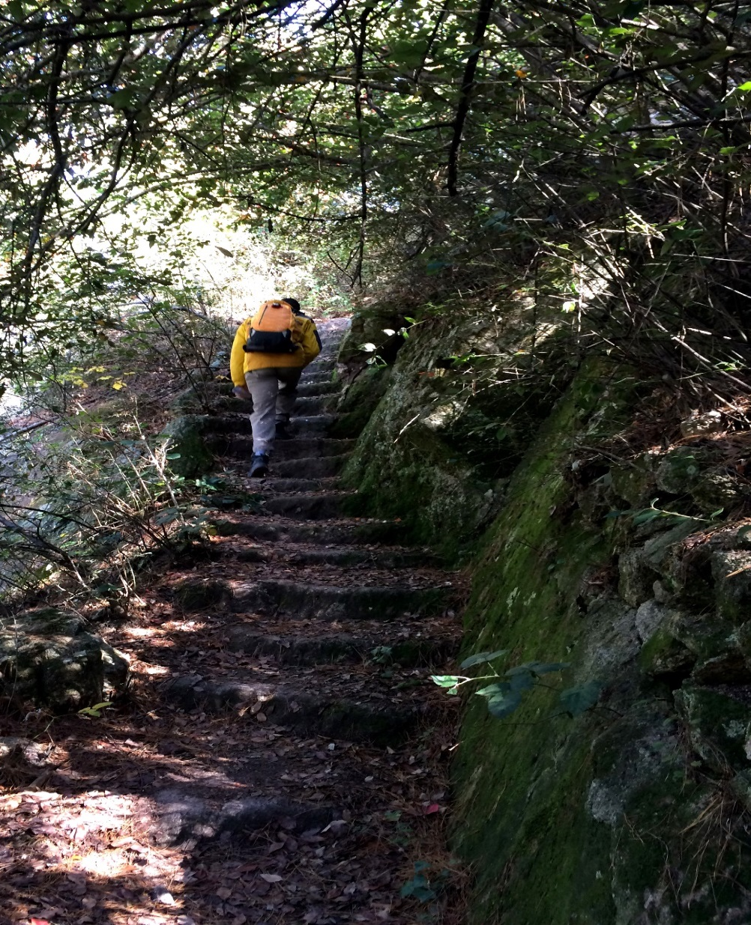
Together, listening to the Holy Spirit, let us be led by God
We stand before You, Holy Spirit, as we gather together in Your name.
With You alone to guide us, make Yourself at home in our hearts; Teach us the way we must go
and how we are to pursue it.
We are weak and sinful;
do not let us promote disorder. Do not let ignorance
lead us down the wrong path
nor partiality influence our actions.
Let us find in You our unity
so that we may journey together
to eternal life and not stray
from the way of truth and what is right.
All this we ask of You, who are at work in every place and time, in the communion of the Father and the Son, forever and ever. Amen.
2

Slide 3
The Challenge of Synodality
“What the Lord is asking of us is already in some sense present in the very word “Synod.” Journeying together – laity, pastors, the Bishop of Rome – is an easy concept to put into words, but not so easy to put into practice.”
Pope Francis, Address at the Ceremony Commemorating the 50th Anniversary
of the Institution of the Synod of Bishops,
October 17 2015
Notes:
NOTES
http://www.vatican.va/content/francesco/en/speeches/2015/october/documents/papa-francesco_20151017_50-anniversario-sinodo.html
We must continue along this path. The world in which we live, and which we are called to love and serve, even with its contradictions, demands that the Church strengthen cooperation in all areas of her mission. It is precisely this path of synodality which God expects of the Church of the third millennium. (Pope Francis, Address at the Commemoration of the 50th Anniversary of the Institution of the Synod of Bishops) * * *
“What the Lord is asking of us is already in some sense present in the very word “Synod.” Journeying together – laity, pastors, the Bishop of Rome – is an easy concept to put into words, but not so easy to put into practice.” (Pope Francis, Address at the Commemoration of the 50th Anniversary of the Institution of the Synod of Bishops)

Slide 4
7

Slide 5
The aim of the Synod
To learn synodality
Reread and Practice
The Synodal conversion of the Church
Putting into practice the Synodal nature of the entire Church

Slide 6
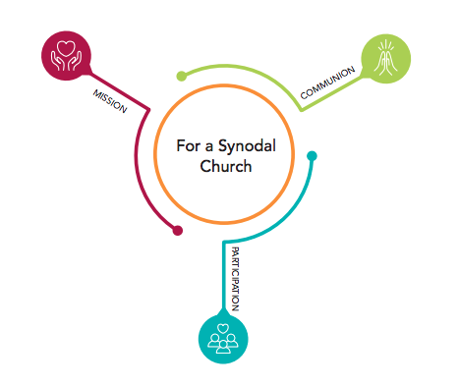
Communion, Participation and Mission
-
3 indispensable keys
at the heart of a Synodal Church

Slide 7
From an event to a process
What’s new in Episcopalis Communio:
Article 4: Phases of the Synodal Assembly
Each Synodal Assembly unfolds in a series of phases:
The preparatory phase
The discussion phase (also known as the phase of celebration)
The implementation phase
Notes:
The “discussion phase” is known as the “phase of celebration” in French, Italian, Spanish, Polish, and Portuguese and the “execution phase” in German

Slide 8
Episcopalis Communio emphasizes the local phase
§ 6: “The Synod of Bishops must increasingly become a privileged instrument for listening to the People of God.”
§ 7: “The history of the Church bears ample witness to the importance of consultation for ascertaining the views of the Bishops and the faithful in matters pertaining to the Good of the Church. Hence, even in the preparation of Synodal Assemblies, it is very important that the consultation of all the particular Churches be given special attention.”
§ 7: “The synodal process not only has its point of departure but also its point of arrival in the People of God, upon whom the gifts of grace bestowed by the Holy Spirit through the gathering of Bishops in Assembly must be poured out.”
Notes:
EPISCOPALIS COMMUNIO, nos. 6-7
“6. Similarly, the Synod of Bishops must increasingly become a privileged instrument for listening to the People of God: “For the Synod Fathers we ask the Holy Spirit first of all for the gift of listening: to listen to God, that with him we may hear the cry of the people; to listen to the people until breathing in the desire to which God calls us”.[23]
“Although structurally it is essentially configured as an episcopal body, this does not mean that the Synod exists separately from the rest of the faithful. On the contrary, it is a suitable instrument to give voice to the entire People of God, specifically via the Bishops, established by God as “authentic guardians, interpreters and witnesses of the faith of the whole Church”,[24] demonstrating, from one Assembly to another, that it is an eloquent expression of synodality as a “constitutive element of the Church”.[25]
“Therefore, as John Paul II declared, “Every General Assembly of the Synod of Bishops is a powerful ecclesial experience, even if some of its practical procedures can always be perfected. The Bishops assembled in Synod represent in the first place their own Churches, but they are also attentive to the contributions of the Episcopal Conferences which selected them and whose views about questions under discussion they then communicate. They thus express the recommendation of the entire hierarchical body of the Church and finally, in a certain sense, the whole Christian people, whose pastors they are”.[26]
“7. The history of the Church bears ample witness to the importance of consultation for ascertaining the views of the Bishops and the faithful in matters pertaining to the good of the Church. Hence, even in the preparation of Synodal Assemblies, it is very important that consultation of all the particular Churches be given special attention. In this initial phase, following the indications of the General Secretariat of the Synod, the Bishops submit the questions to be explored in the Synodal Assembly to the priests, deacons and lay faithful of their Churches, both individually and in associations, without overlooking the valuable contribution that consecrated men and women can offer. Above all, the contribution of the local Church’s participatory bodies, especially the Presbyteral Council and the Pastoral Council, can prove fundamental, and from here “a synodal Church can begin to emerge”.[27]
“During every Synodal Assembly, consultation of the faithful must be followed by discernment on the part of the Bishops chosen for the task, united in the search for a consensus that springs not from worldly logic, but from common obedience to the Spirit of Christ. Attentive to the sensus fidei of the People of God – “which they need to distinguish carefully from the changing currents of public opinion”[28] – the members of the Assembly offer their opinion to the Roman Pontiff so that it can help him in his ministry as universal Pastor of the Church. From this perspective, “the fact that the Synod ordinarily has only a consultative role does not diminish its importance. In the Church the purpose of any collegial body, whether consultative or deliberative, is always the search for truth or the good of the Church. When it is therefore a question involving the faith itself, the consensus ecclesiae is not determined by the tallying of votes, but is the outcome of the working of the Spirit, the soul of the one Church of Christ”.[29] Therefore the vote of the Synod Fathers, “if morally unanimous, has a qualitative ecclesial weight which surpasses the merely formal aspect of the consultative vote”.[30]
“Finally, the Synod Assembly itself must be followed by the implementation phase, so as to initiate the reception of the Synod’s conclusions in all the local Churches, once they have been accepted by the Roman Pontiff in the manner he judges most appropriate. Here it must be remembered that “cultures are in fact quite diverse, and every general principle… needs to be inculturated, if it is to be respected and applied”.[31] In this way, it can be seen that the synodal process not only has its point of departure but also its point of arrival in the People of God, upon whom the gifts of grace bestowed by the Holy Spirit through the gathering of Bishops in Assembly must be poured out.”

Slide 9
Episcopalis Communio emphasizes the local phase
Art. 6: Consultation of the People of God
§ 1. The consultation of the People of God takes place in the particular Churches […]
In each particular Church, the Bishops carry out the consultation of the People of God by recourse to the participatory bodies provided for by the law, without excluding other methods that they deem appropriate

Slide 10
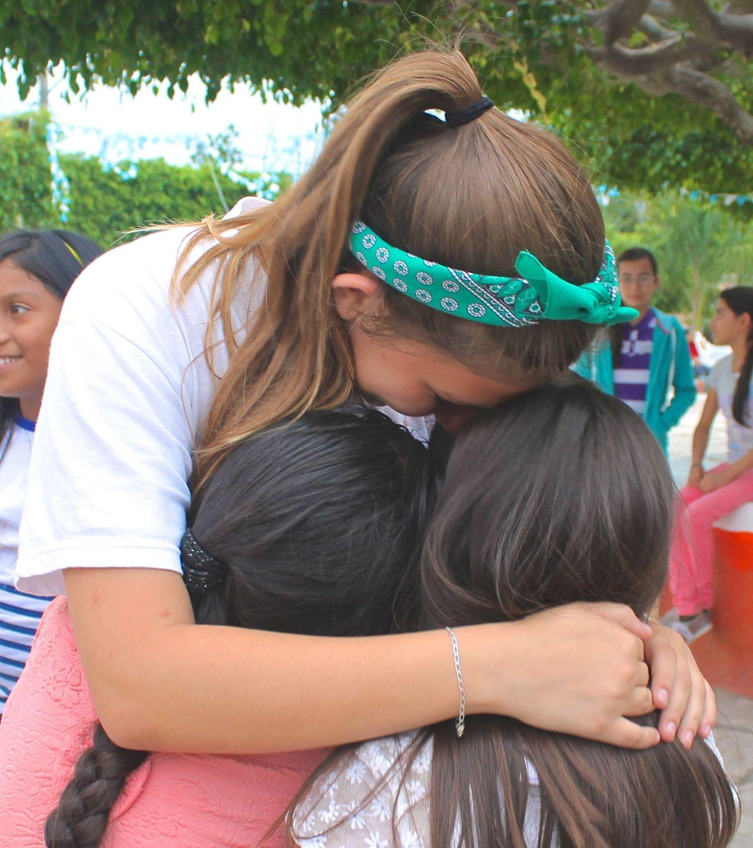
Basic Question of the Synodal Process
A basic question prompts and guides us: How does this “journeying together,” which takes place today on different levels (from the local level to the universal one), allow the Church to proclaim the Gospel in accordance with the mission entrusted to her; and what steps does the Spirit invite us to take in order to grow as a synodal Church?
The fundamental question for the consultation of the People of God
A synodal Church, in announcing the Gospel, “journeys together:” How is this “journeying together” happening today in your local Church? What steps does the Spirit invite us to take in order to grow in our “journeying together”?
(PD, 26)

Slide 11
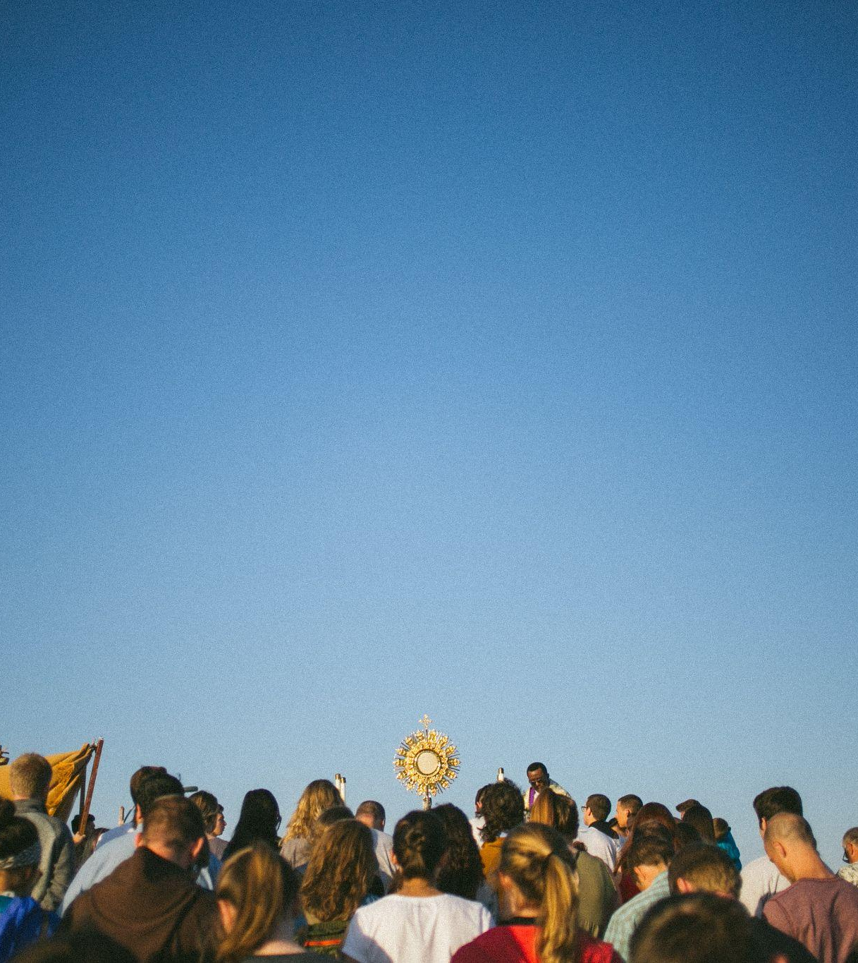
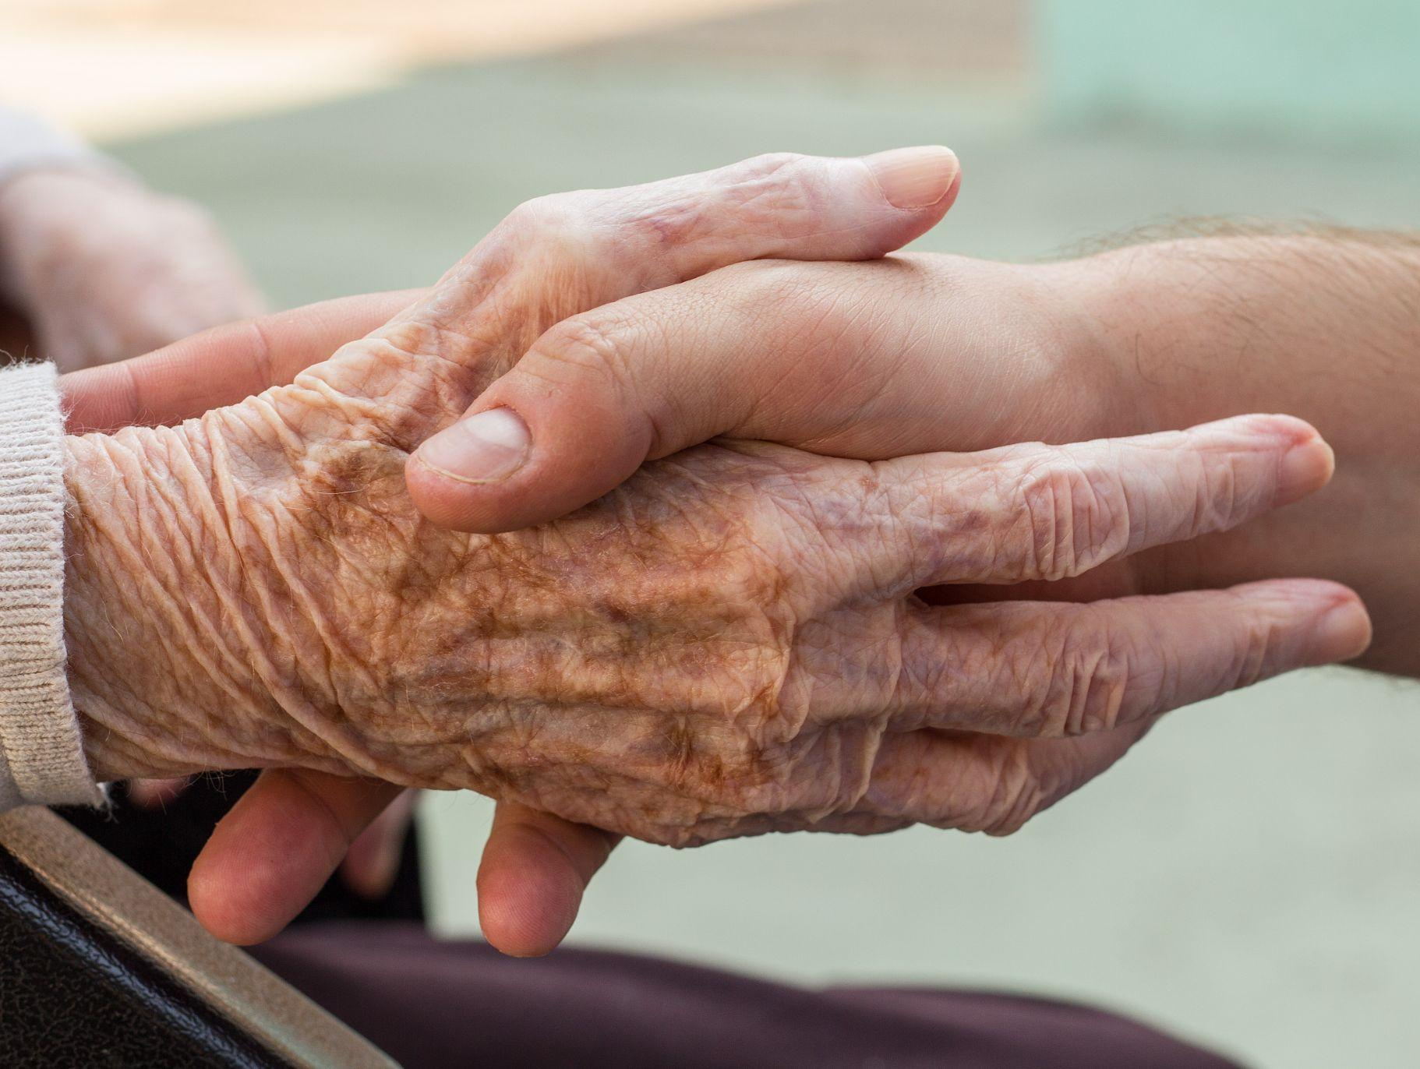
“The purpose of the Synod, and therefore of this consultation, is not to produce documents, but “to plant dreams, draw forth prophecies and visions, allow hope to be nourished, inspire trust, bind up wounds, weave together relationships, awaken a dawn of hope, learn from one another, and create a bright resourcefulness that will enlighten minds, warm hearts, give strength to our hands.”
(PD, 32)
15
Notes:
El texto citado viene de: Papa Francisco, Discurso al inicio del Sínodo dedicado a los jóvenes (3 de octubre de 2018).

Slide 13
Preparatory Document
Vademecum
The Call to Journey Together
A Constitutively Synodal Church
Listening to the Scriptures
Jesus, the Crowd, the Apostles
A Double Dynamic of Conversion: Peter and Cornelius (Acts 10)
Synodality in Action: Pathways for Consulting the People of God
Introduction
Principles of a Synodal Process
The Process of the Synod
Travelling the Synodal Path in Dioceses
Resources for organizing the Synodal Process
+ Appendices, materials, and tools (biblical, liturgical, methodological, and practical resources, etc.)
Notes:
+ Appendices, materials, and tools (biblical, liturgical, methodological, and practical resources, etc.)

Slide 14
The Objectives of the Synod (PD, 2)
recalling how the Spirit has guided the Church’s journey through history and, today, calls us to be, together, witnesses of God’s love;
living a participative and inclusive ecclesial process that offers everyone—especially those who for various reasons find themselves on the margins—the opportunity to express themselves and to be heard in order to contribute to the edification of the People of God;
recognizing and appreciating the wealth and the variety of the gifts and charisms that the Spirit liberally bestows for the good of the community and the benefit of the entire human family;
exploring participatory ways of exercising responsibility in the proclamation of the Gospel and in the effort to build a more beautiful and habitable world

Slide 15
The Objectives of the Synod (PD, 2)
examining how responsibility and power are lived in the Church as well as the structures by which they are managed, bringing to light and trying to convert prejudices and distorted practices that are not rooted in the Gospel
accrediting the Christian community as a credible subject and reliable partner in paths of social dialogue, healing, reconciliation, inclusion and participation, the reconstruction of democracy, the promotion of fraternity and social friendship
regenerating relationships among members of Christian communities as well as between communities and other social groups, e.g., communities of believers of other denominations and religions, civil society organizations, popular movements, etc
fostering the appreciation and appropriation of the fruits of recent synodal experiences on the universal, regional, national, and local levels

Slide 16
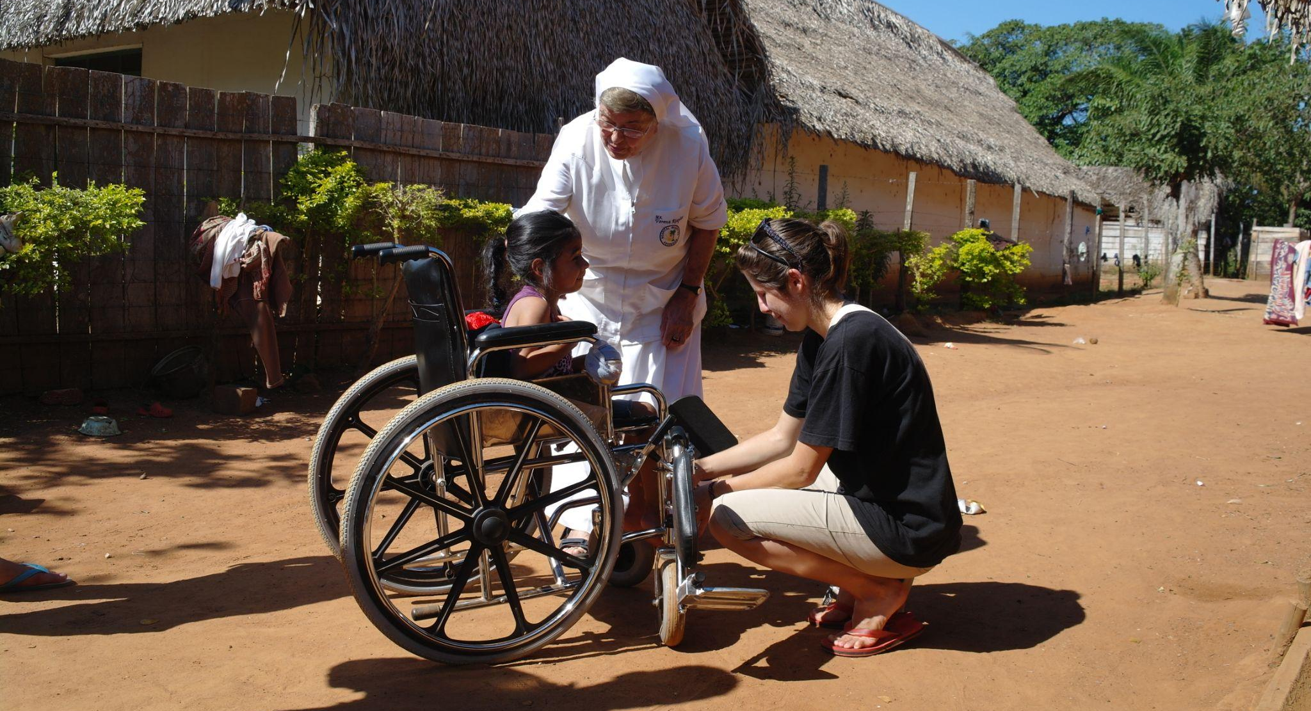
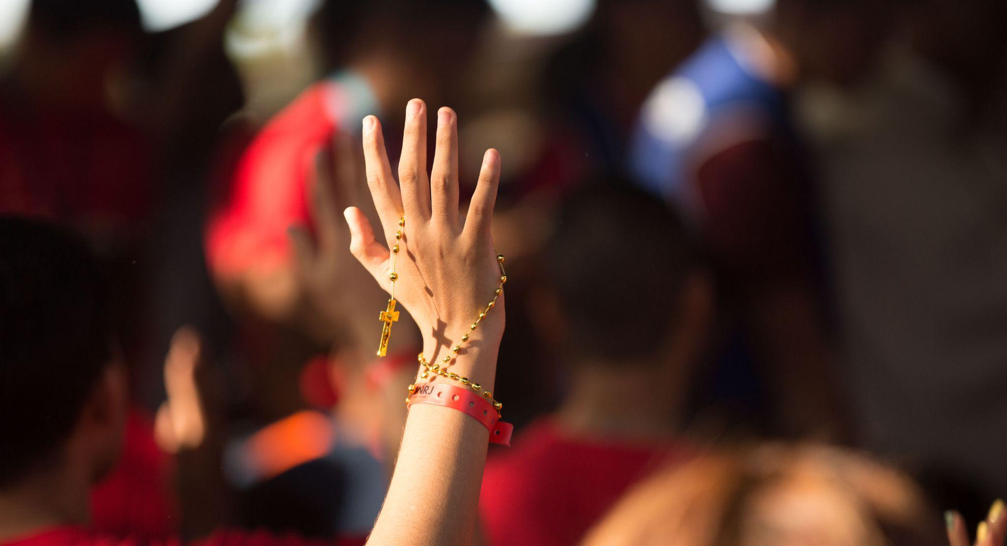
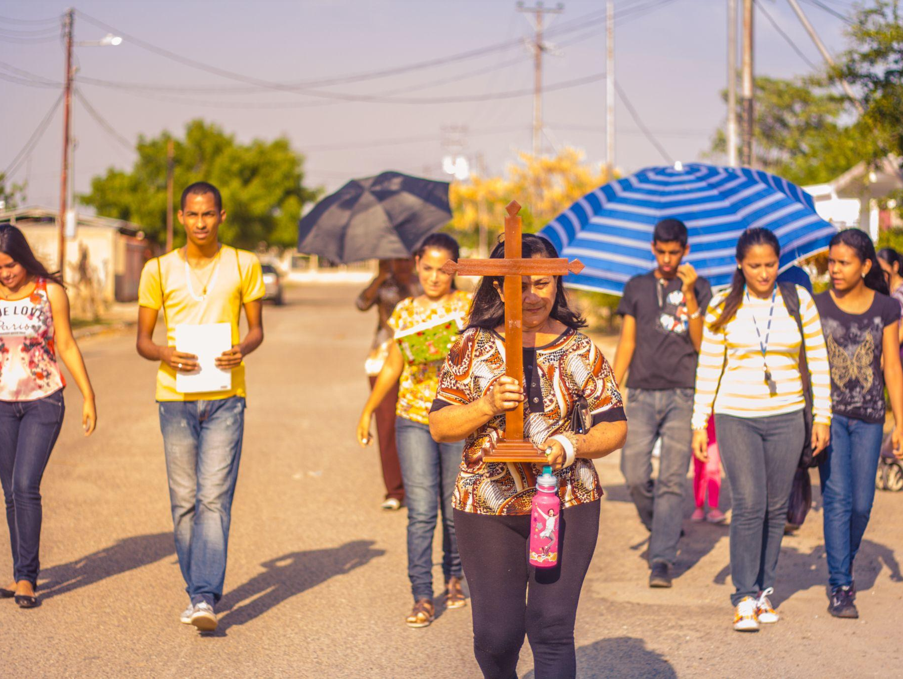
Key convictions for a Synodal Church
Listen to one another in order to listen to the Holy Spirit
In a spirit of prayer, grounded in the liturgy and the Word of God
An experience shared with one another, not just filling out a questionnaire
A process, not a one-time event
Discerning together so that the decisions made are for the good of all

Slide 17
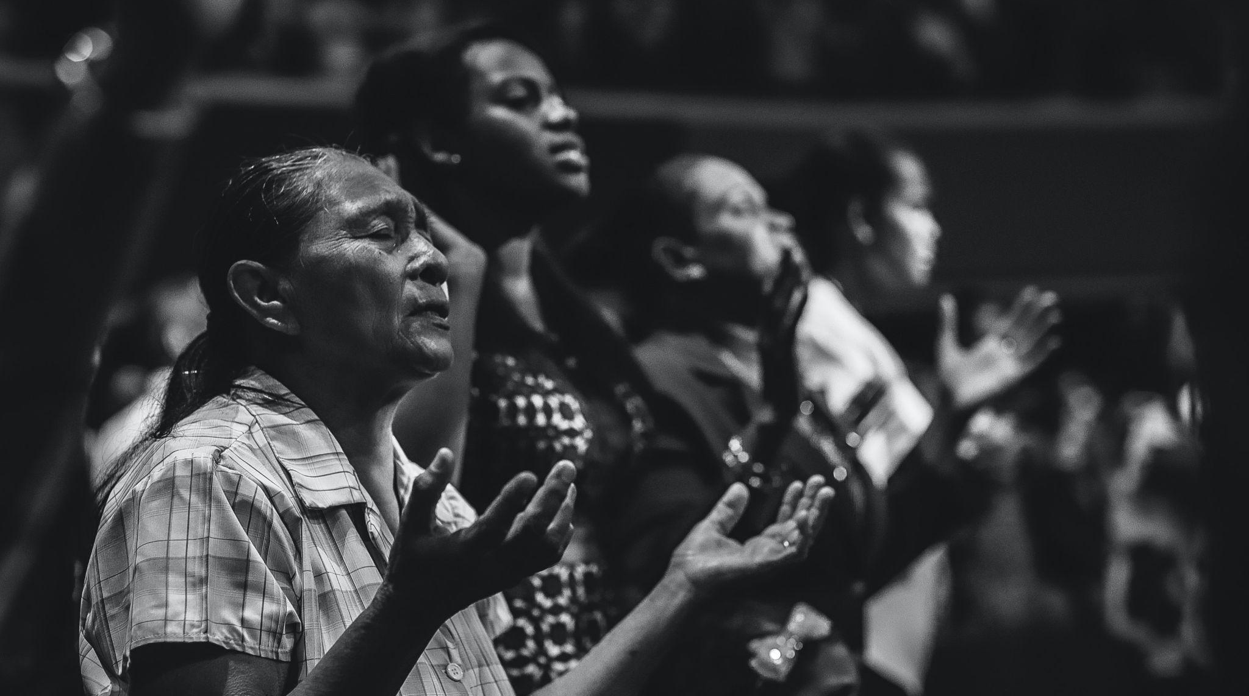

Slide 18
Discerning the signs of the times in the light of the Gospel
“The synodal journey unfolds within a historical context marked by epochal changes in society and by a crucial transition in the life of the Church, which cannot be ignored: it is within the folds of the complexity of this context, in its tensions and contradictions, that we are called to ‘scrutinize the signs of the times and interpret them in the light of the Gospel’ (GS, 4).”
(PD, 4)
The global tragedy of the COVID-19 pandemic
Inequalities and injustices: massification, fragmentation, the conditions faced by migrants, divisions across the family of humanity
The cry of the poor and the cry of the earth
We are all in the same boat…We are one human family living in our common home.
(Laudato Si’ and Fratelli Tutti)

Slide 19
“Within this context, synodality represents the main road for the Church, called to renew herself under the action of the Spirit and by listening to the Word.” (PD, 9)
Imagining a different future for the Church
Being a prophetic witness to the human family, which needs to be united around a common goal

Slide 20
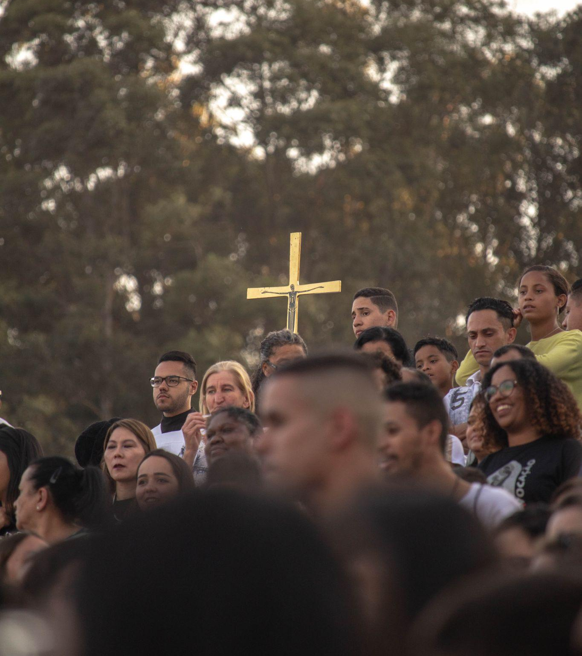
Listening to the Scriptures
Jesus, the Crowd, and the Apostles
“The work of evangelization and the message of salvation would not be comprehensible without Jesus’ constant openness to the widest possible audience, which the Gospels refer to as the crowd, that is, all the people who follow him along the path, and at times even pursue him in the hope of a sign and a word of salvation: this is the second actor on the scene of Revelation. The proclamation of the Gospel is not addressed only to an enlightened or chosen few.” (PD, 18)
In order for the Church to be herself, and for her mission to bear fruit, all three must always be present: Jesus, the crowd, and the apostles!

Slide 21
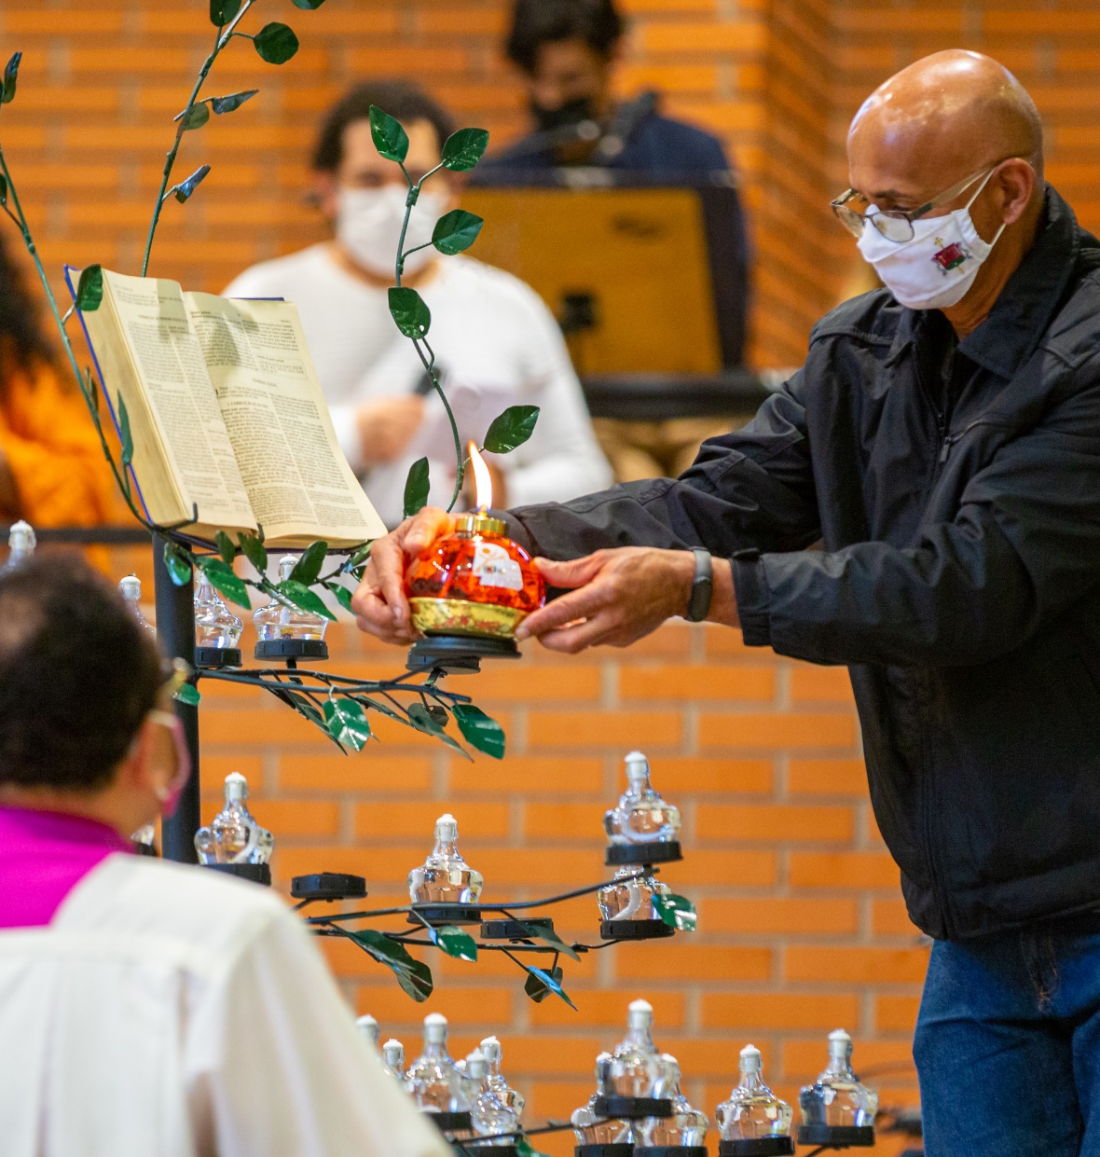
Listening to the Scriptures
A Double Dynamic of Conversion:
Peter and Cornelius (Acts 10)
“It is in the encounter with people, welcoming them, journeying with them, and entering their homes, that he realizes the meaning of his vision: no human being is unworthy in the eyes of God, and the difference established by election does not imply exclusive preference but service and witnessing of a universal breadth.” (PD, 23)

